Slide 1
Long Combination (k length)
Short Combination (s length)
Value Table
AA
AA
1, 2, 3
1, 2, 4
1, 2, 5
1, 3, 4
1, 3, 5
1, 4, 5
2, 3, 4
2, 3, 5
2, 4, 5
3, 4, 5
Value
1, 2, 3, 4
1, 2, 3, 5
1, 2, 4, 5
1, 3, 4, 5
2, 3, 4, 5
1, 2, 3, 4 4
1, 2, 3, 5 4
1, 2, 4, 5 4
1, 3, 4, 5 4
2, 3, 4, 5 4

Slide 2
Long Combination (k length)
Short Combination (s length)
Value Table
AA
AA
AA
1, 2, 3
1, 2, 4
1, 2, 5
1, 3, 4
1, 3, 5
1, 4, 5
2, 3, 4
2, 3, 5
2, 4, 5
3, 4, 5
Value
1, 2, 3, 4
1, 2, 3, 5
1, 2, 4, 5
1, 3, 4, 5
2, 3, 4, 5
1, 2, 3, 4 4
1, 2, 3, 5 4
1, 2, 4, 5 4
1, 3, 4, 5 4
2, 3, 4, 5 4
Validation sets
1, 2, 3, 4
1, 2, 3, 4

Slide 3

Long Combination (k length)
Short Combination (s length)
Value Table
AA
1, 2, 5
1, 3, 5
1, 4, 5
2, 3, 5
2, 4, 5
3, 4, 5
AA
Value
1, 2, 3, 5
1, 2, 4, 5
1, 3, 4, 5
2, 3, 4, 5
1, 2, 3, 5 3
1, 2, 4, 5 2
1, 3, 4, 5 3
2, 3, 4, 5 3
Validation sets
11, 2 1, 2, 3, 5, 3, 4
1, 2, 3, 4

Slide 4
Cold Start
Initial State
1st iteration
2nd iteration
AA
AA
AA
Value
Value
Value
1, 2, 4, 5 2
1, 3, 4, 5 2
2, 3, 4, 5 1
1, 2, 3, 4 4
1, 2, 3, 5 4
1, 2, 4, 5 4
1, 3, 4, 5 4
2, 3, 4, 5 4
1, 2, 3, 5 3
1, 2, 4, 5 2
1, 3, 4, 5 3
2, 3, 4, 5 3

Slide 5
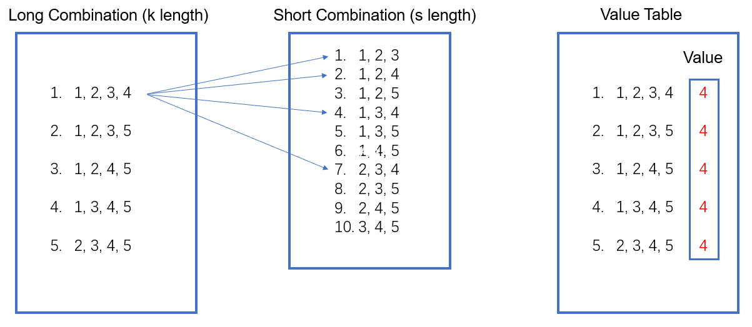
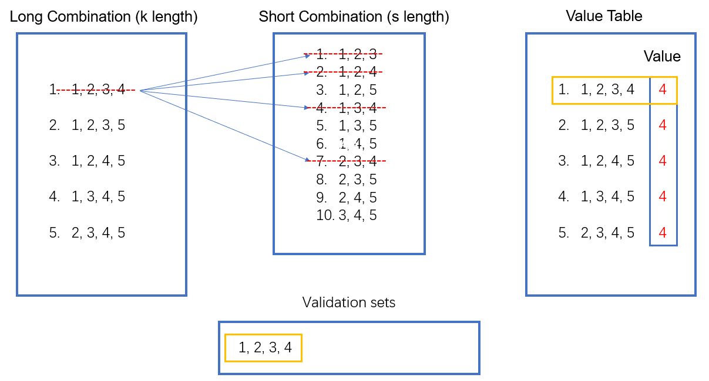
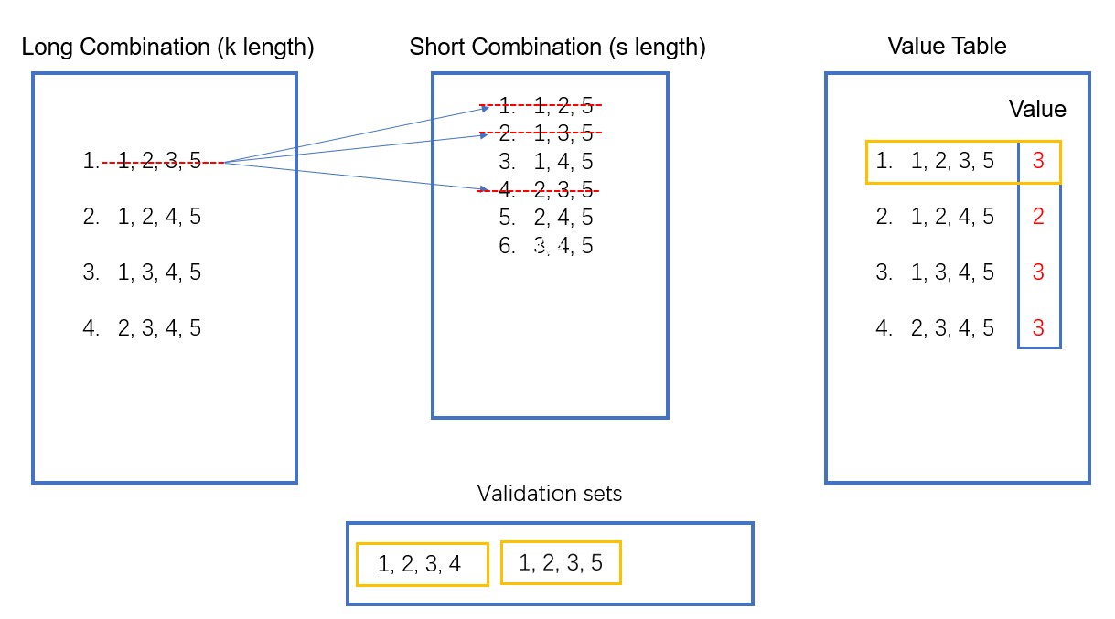
Initial State
AA
1st iteration
AA
2nd iteration
AA

Slide 6
Short Combination (s length)
Long Combination (k length)
1, 2, 3
1, 2, 4
1, 2, 5
1, 3, 4
1, 3, 5
1, 4, 5
2, 3, 4
2, 3, 5
2, 4, 5
3, 4, 5
Value Table
AA
AA
Value
1, 2, 3, 4
1, 2, 3, 5
1, 2, 4, 5
1, 3, 4, 5
2, 3, 4, 5
1, 2, 3, 4 3
1, 2, 3, 5 3
1, 2, 4, 5 2
1, 3, 4, 5 2
2, 3, 4, 5 0
Segment Short Combination
1, 2, 3
1, 2, 4
1, 2, 5
1, 3, 4
1, 3, 5
Update

Slide 7
Long Combination (k length)
Segment Short Combination
Value Table
AA
1, 2, 3
1, 2, 4
1, 2, 5
1, 3, 4
1, 3, 5
AA
Value
Update
1, 2, 3, 4
1, 2, 3, 5
1, 2, 4, 5
1, 3, 4, 5
2, 3, 4, 5
1, 2, 3, 4 3
1, 2, 3, 5 3
1, 2, 4, 5 2
1, 3, 4, 5 2
2, 3, 4, 5 0
Validation sets
11, 2 1, 2, 3, 5, 3, 4
1, 2, 3, 4

Slide 8
Value Table
Max Value is 3
Repeat Time is 2
AA
Value
1, 2, 3, 4 3
1, 2, 3, 5 3
1, 2, 4, 5 2
1, 3, 4, 5 2
2, 3, 4, 5 0

Slide 9
Short Combination (j length)
Shorter Combination (s length)
1, 2, 3
1, 2, 4
1, 2, 5
1, 3, 4
1, 3, 5
1, 4, 5
2, 3, 4
2, 3, 5
2, 4, 5
3, 4, 5
1, 2
1, 3
2, 3
1, 2
1, 4
2, 4
1, 2
1, 2
1, 5
2, 5
…
3, 4
3, 5
4, 5

Slide 10
 | Answer | Our Result | Time
45, 7, 6, 5, 5 | 6 | 6 | 0.027
45, 8, 6, 4, 4 | 7 | 8 | 0.038
45, 9, 6, 4, 4 | 12 | 12 | 0.051
45, 8, 6, 6, 5 | 4 | 4 | 0.036
45, 9, 6, 6, 4 | 3 | 4 | 0.031
45, 12, 6, 6, 4 | 6 | 8 | 0.085

Slide 11
 | Nearly optimal solution | Our Result | Time
45, 10, 6, 5, 5 | 50 | 56 | 0.548
45, 12, 6, 5, 5 | 132 | 189 | 11.539
45, 13, 6, 5, 5 | 245 | 299 | 44.614
45, 10, 6, 4, 4 | 37 | 21 | 0.158
45, 12, 6, 4, 4 | 42 | 57 | 2.621
45, 16, 6, 4, 4 | 162 | 193 | 212.867
45, 11, 6, 6, 5 | 26 | 24 | 0.164
45, 12, 6, 6, 5 | 42 | 46 | 0.887
45, 16, 6, 6, 5 | 280 | 252 | 200.034
45, 12, 6, 5, 4 | 18 | 19 | 0.294
45, 13, 6, 5, 4 | 28 | 27 | 0.941
45, 16, 6, 5, 4 | 65 | 66 | 23.783
45, 12, 6, 6, 4 | 6 | 8 | 0.0749
45, 13, 6, 6, 4 | 12 | 10 | 0.191
45, 16, 6, 6, 4 | 38 | 24 | 3.147

Slide 12
